Slide 1
Breeding Sheep & Breeding Goats
Compiled by:
Jared Jackson

Slide 2
Sheep Terminology
Lamb- A sheep that is under one year of age
Ewe lamb- A female sheep under one year of age
Ram lamb- intact male that is under one year of age
Wether- castrated male sheep that is under one year of age
Ewe- a female sheep that is over one year of age
Ram- a male sheep that is over one year of age
Mutton- a castrated male sheep that is over one year of age
Flock- is a group of sheep

Slide 3
Goat Terminology
Kid- a goat that is under one year of age
Doe- female goat
Buck- male goat
Wether- a castrated goat of any age
Nanny- slang term for a female goat
Billy- slang term for a male goat

Slide 4
U.S. Sheep Breeds

Slide 5
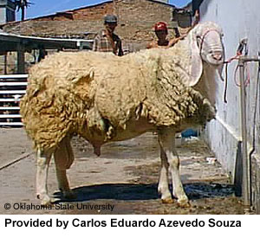
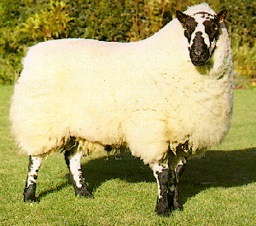
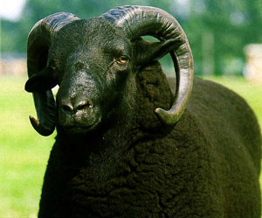
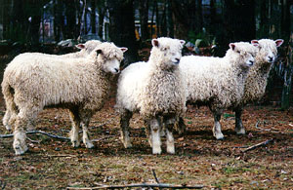
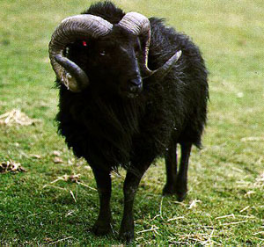
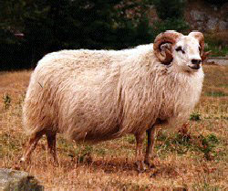
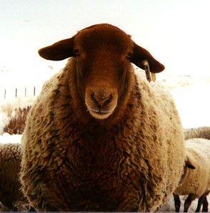
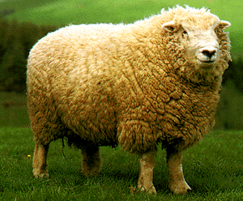
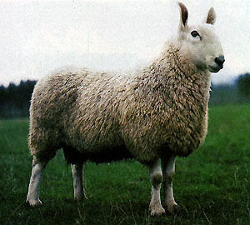
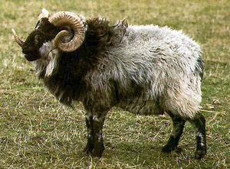
World Sheep Breeds
Breeds of Sheep
235 breeds world wide

Slide 6
Sheep Type
Frame- Sheep Genetics Lines that are selected for Growth, Skeletal Size (Frame), and Skeletal Design
Wether- Sheep Genetic Lines that are selected for carcass merit, meat production, market show lamb production

Slide 7
US Sheep Breeds
- 26 – 30 Breeds in US
- Only 8- 10 Industry Impact
Three Classifications
Fine Wool Breeds
Medium Wool Breeds
Hair Breeds

Slide 8
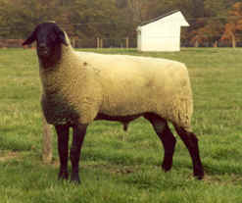
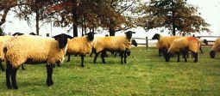

Slide 9
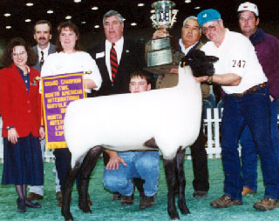
Medium Wool Breeds
Suffolk
Developed:
Suffolk county England
Characteristics:
Black head and legs (Free of any wool)
Largest breed of sheep
Rams up to 350 lbs
Ewe up to 250 lbs
Classification- Medium Wool
Noted For:
Rapid growth rates, and carcass traits
Meat Breed

Slide 10
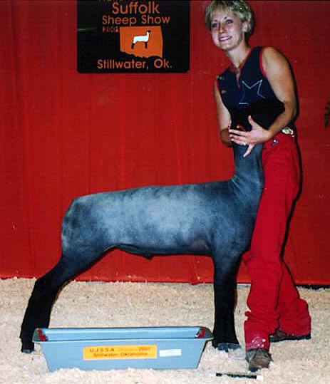
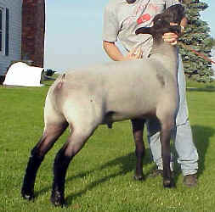
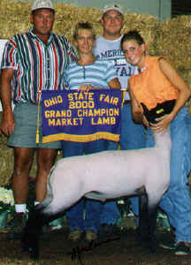
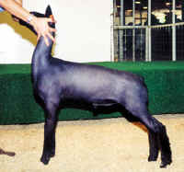

Slide 11
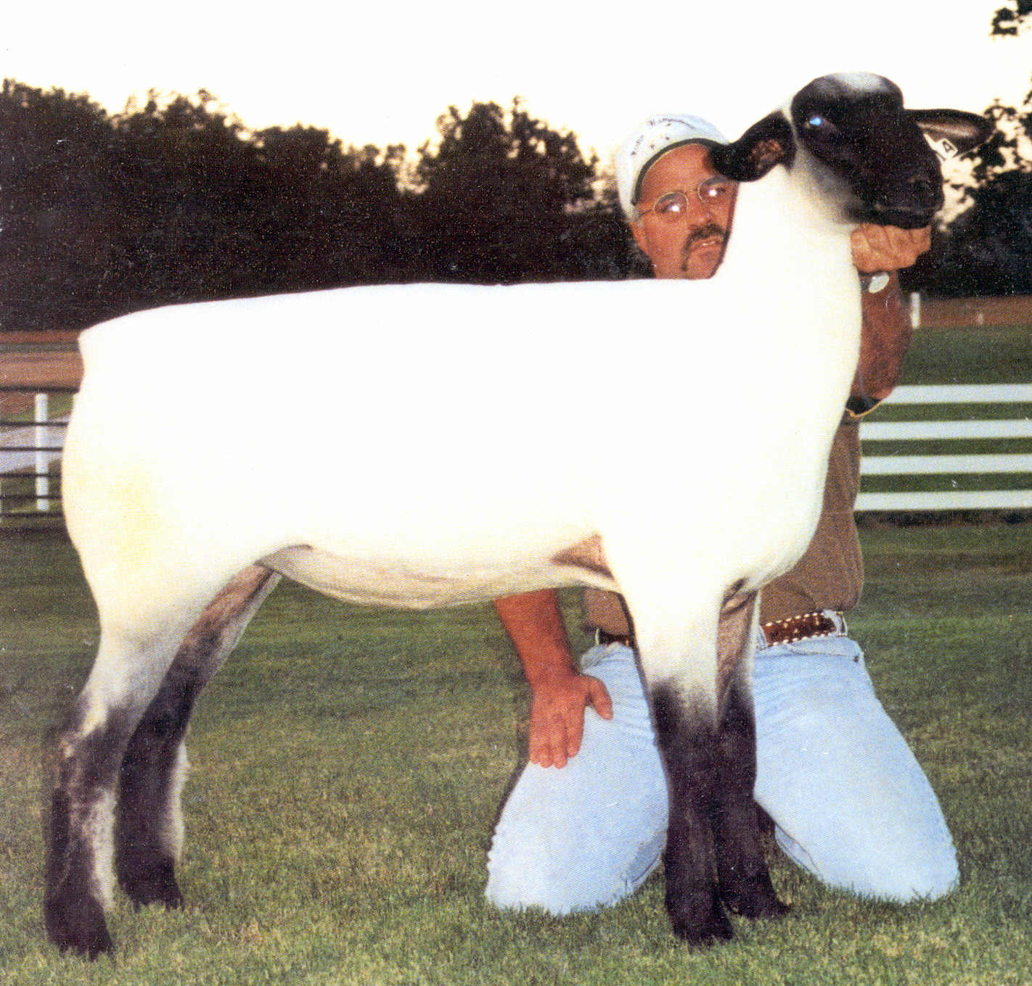

Slide 12
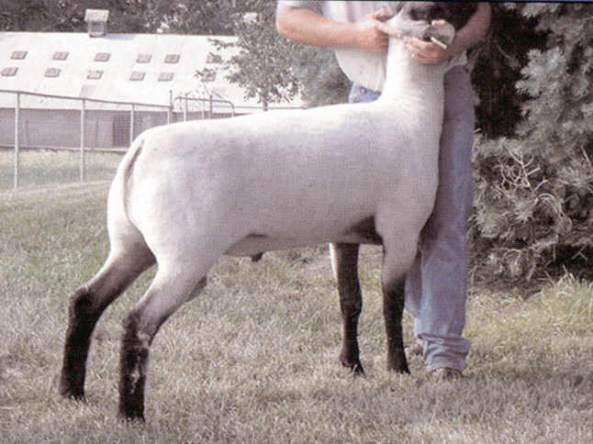
Medium Wool Breeds
Hampshire
Developed:
Hampshire county England
Characteristics:
Black head and legs with wool on them
Rams can weigh up to 325
Ewes can weigh up to 225 lbs
Classification- Medium Wool
Noted For:
Fast rates of growth and excellent muscling
Meat Breed

Slide 13
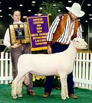
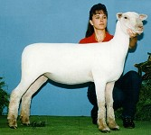

Slide 14
Medium Wool Breeds
Southdowns
Developed:
Hampshire county England
Characteristics:
Mouse colored muzzle and legs with wool on legs
Smaller sized
Rams can weigh up to 200
Ewes can weigh up to 150 lbs
Classification- Medium Wool
Noted For:
Calm docile sheep, gained popularity due to size for young exhibitors
Meat Breed

Slide 15
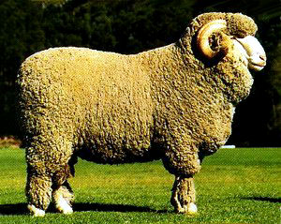

Slide 16
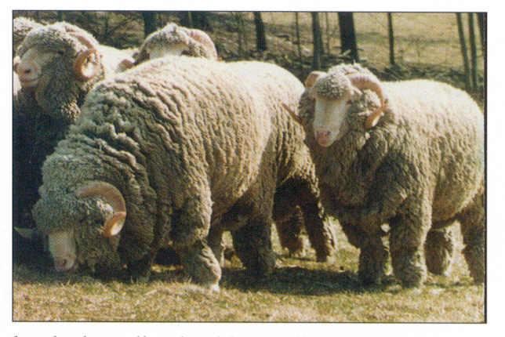
Fine Wool Breeds
Delaine-Merino
Developed:
Spain
Characteristics:
White points, long fleece
Rams 220 lbs, Ewes 150 lbs
Classification- Fine Wool
Noted For:
Highest Quality fleece , up to 14 lbs
Finest Fleece
Maternal Strengths

Slide 17
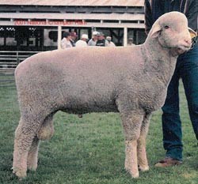
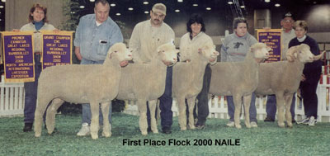

Slide 18
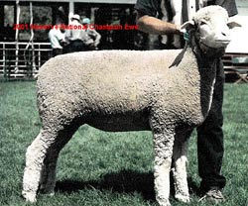
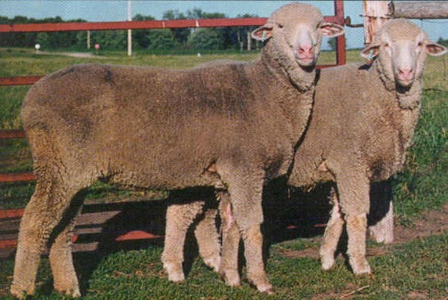
Fine Wool Breeds
Rambouillet
Developed:
In France from Merino
Characteristics:
White with long wool
Ram 300 lbs, ewe 250 lbs
Classification- Fine Wool
Noted For:
Excellent mothering
Hardiness – Western Breed
Quality wool,
Heavy fleece up to 18 lbs

Slide 19
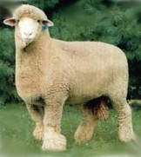

Slide 20
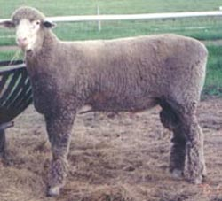
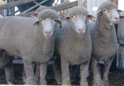
Medium Wool Breeds
Columbia
Developed:
First breed developed in the US
Univ of Wyoming
Western Range
Rambioullet X Lincoln (meat)
Characteristics:
Large Rams
Classification- Fine Wool
Noted For:
Mothering Characteristics
Good Carcasses
Dual Purpose Breed

Slide 21
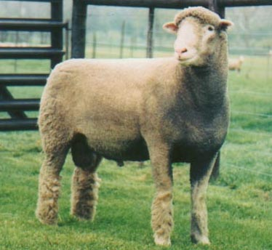
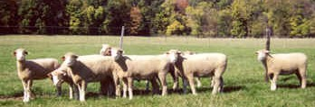

Slide 22
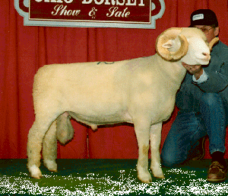
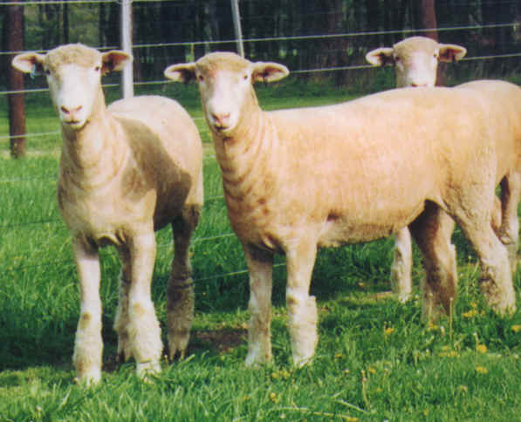
Medium Wool Breeds
Dorset
Developed:
England
Characteristics:
White face – horned and polled
Smaller meatier sheep
Rams 250 lbs, Ewes 175 lbs
Classification- Fine Wool
Noted For:
Breeds out of season
Excellent mothering
Excellent carcass
Dual Purpose Breed

Slide 23
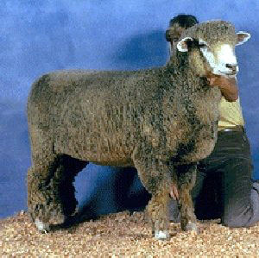
Medium Wool Breeds
Corriedale
Cross between Merino and Lincoln or Leicester
Developed in New Zealand
Polled
Classification- Fine Wool
Dual Pupose Breed

Slide 24
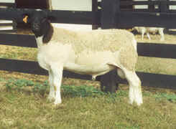
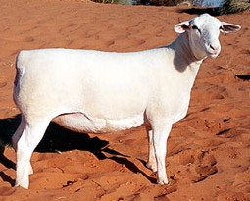

Slide 25
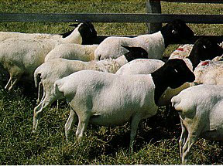
Developed
Black Headed Persian
South African Breed
Dorset
English Breed

Slide 26
Hair Breeds
Dorper
Developed:
South Africa
Meat breed that is heat tolerant
Characteristics:
No wool or very little
Medium size
Rams 200 lbs
Ewe 150 lbs
Noted For:
Meat and reproductive traits
No shearing
Fast Growing Sector in the Sheep and Goat Industry in Texas

Slide 27
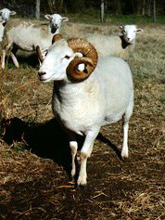
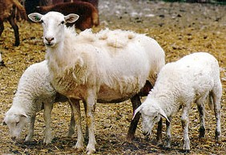
Dorper
Wiltshire Horn
Katahdin

Slide 28
Goat Breeds
4 classifications
Dairy
Dual Purpose
Meat
Hair

Slide 29
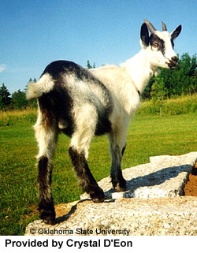
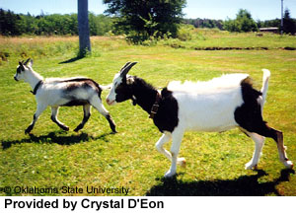
Origin: French Alps
Dairy type
Hardy
Colors:
White
Fawn
Grey
Black brown
Alpine

Slide 30
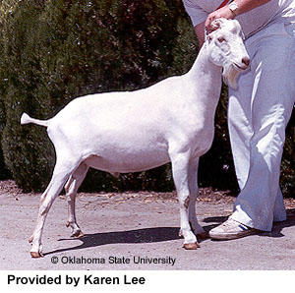
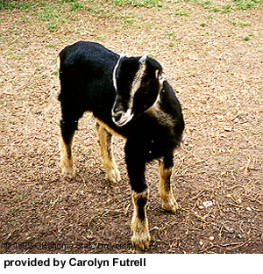
Lamancha
Origin:Oregon
Short Ears
Dairy Type

Slide 31
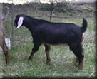
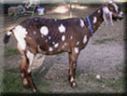
Nubian
Origin: England
Dual purpose
Very popular cross with meat type goats
Large frame
Extended breeding season
Adapts to hot environment

Slide 32
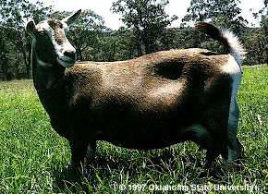
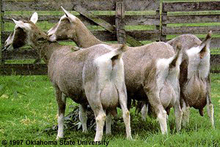
Toggenburg
Origin: Switzerland
Dual Purpose
Oldest known dairy breed
Medium frame size
Dark color with white ears and white stripes down face.
Excellent udder quality
Best suited for cool climates

Slide 33
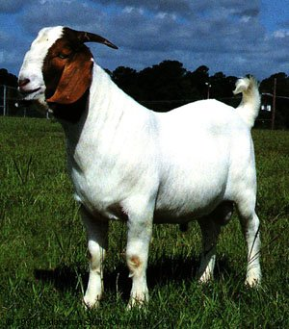
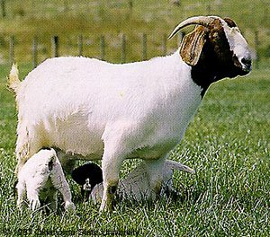
Origin: South Africa
Meat Type
Horned
Early Puberty
Extended Breeding Season
Heavy Muscle
Most popular Breed of Goat in the USA
Boer

Slide 34

Spanish
Origin: U.S. (1500’s)
Small/ Agile
Hardy
Small Udders
Good foragers

Slide 35


Angora
Origin: Angora
Hair Type
Mohair Production
Sheared twice/year
Horned
Small Frame
Require extra management at Kidding

Slide 36


Cashmere
Any breed that produces Cashmere mohair
Cashmere – fine, soft, winter undercoat produced by secondary follicles
desired to be less than 19 micrometers
Origin – Australia & New Zealand

Slide 37
Life Cycle of Breeding Ewe
Parturition (150 days)
Breeding ( Following September – December)
Sexual Puberty (6-8 months)
Weaned (~60 days)
Born
Weaned(60days)
Death 10-11 yrs
First Breeding (10-12 months)***
Optimal Productive Life (2-5 yrs)
**** Some club lamb/seedstock producers will skip a breeding season and wait to breed replacement ewes until they are just under 2yrs of age

Slide 38
Breeding Patterns
Most sheep are seasonally bred
Most females begin tocycle when days are short and nights are long (Fall)
Lamb in the spring (January- May)
Some breeds cycle year round
Polypays
Dorsets
Finnsheep

Slide 39
Scrapie
In the family of diseases known as Transmissable Spongioform Encephalopathies (TSEs)
Neurodegenerative Brainwasting Diseases
Similar to BSE in cattle, chronic wasting disease in deer
Prion – Affects nervous system
Symptoms
“Star gazing”
Awkward, uncoordinated gait
Loss of wool
Death is imminent
No Treatment
Eradication of infected animals

Slide 40
Scrapie Susceptibility
Determined by codon 171 within the genetic code
RR – Resistant
QR – Resistant, but Carrier
QQ – Susceptible
Determined by blood test
Basic Punnett Sqaure/ Mendalian Genetics Applies

Slide 41
Scrapie Susceptibility Continued Codon 136
AA- free of Scrapie
Av- will show clinical signs of Scrapie
vv- suffering from Scrapie

Slide 42
Spider Gene
A heritable genetic defect that results in skeletal abnormalities
Spider offspring typically do not survive
Basic Punnett Square
NN – normal
NS – carrier
SS – Spider

Slide 43
Performance Evaluation
FEPD- Flock Expected Progeny Difference
Performance data collected and calculated only within the flock
Trait | Abbreviation | Desired
Birth Type | BT | Twin
Reared Type | RT | Twin
Milk | M | Moderate
60/90/120 day weight | 60/90/120 day wt. | High
REA | Rib Eye Area | High
YG | Yield Grade | Low

Slide 44

Phenotypic Evaluation
want neck to tie in high onto the top of shoulder. We also want a shoulder that is laid at a 45 degree angle
Want ewes that are parrallel in their lines and deep bodied
We want to see females that are long sided, feminine, and elegant fronted
Want correctly structure feet and legs that offer a desirable angle to all joints to facilitate a greater range of motion

Slide 45

Observe how much rib shape the female has
Determine how wide they are through their center leg and how square hipped they are
Study how wide they are at the ground to determine base width

